Slide 1

DSLab 2020
The Data Science Lab Week 4

Slide 2
Outline
Industry presentation from Merck
Week 3 - a retrospective
Hive, Hbase and Storage formats (tutorials)
Homework 1

Slide 3
Week 3: retrospective
Week 4: Hive, Hbase and Storage formats

Slide 4
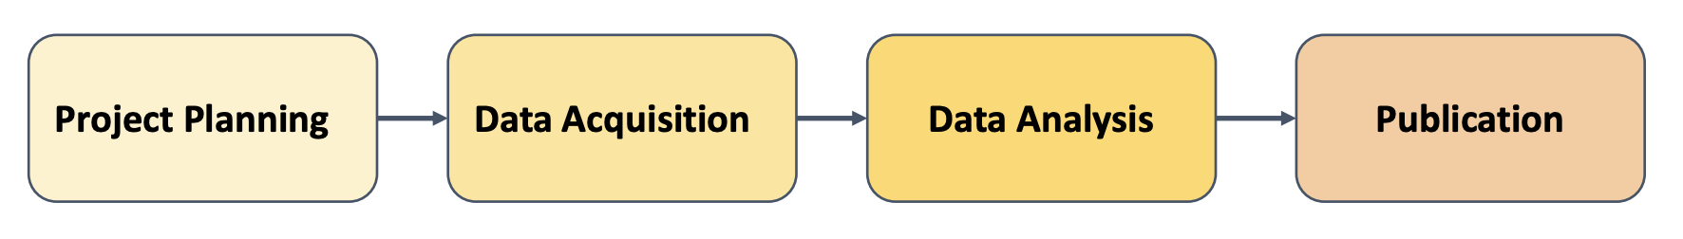
Data Lifecycle: “data” + code + environment
Importing data in data lake (Hive data warehouse) from external files
Exploring data and understanding it (schema, quality)
Mapping data formats to Hive tables
Optimizing data storages (Textfiles -> ORC or Parquet)
Mixing data from various sources, fast data (Hbase) and slow data (HDFS)
Reproducibility, Reusability, Collaboration
Notes:
Data Roadmap, based on Briney, 2015

Slide 5
Popular Storage Formats
Storage format:
This is how the data is physically stored in HDFS
It is not the same as how the data is mapped into tables (which is the schema), a storage type e.g. textfile can map to many schemas (e.g. CSV -> combination of columns, or rows of text).
Big data components (Hive, Spark, etc) give you several formatting options for storing and exchanging data on HDFS, the most popular are
Plain text (csv, json, …) <- this often the format you get from external sources
Parquet:
column-oriented
integrated compression: None, SNAPPY, ZLIB
splittable
ORC:
column-oriented in collections of rows
splittable by row collections
integrated compression: None, SNAPPY, ZLIB
indexed
Avro:
row-oriented,
splittable
support block level compression
Notes:
ORC more control on how files are splitted, some indexing for faster access.
-

Slide 6
HDFS – Hive - HBase
HDFS | Hive | HBase
Distributed file systems | Big data warehouse | Key-value store Wide column store
 | Build on top of Hadoop | Build on top of HDFS
Store on commodity disk storage | Store in HDFS, Hbase and other storages | Store in HDFS storage
Use it for parking data. Do not use it for random access queries | Use it for relational queries in batch on huge data sets Do not use it for random access queries | Use it for random access queries and real-time/fast data. Do not use it for complex/relational queries
Notes:
ORC more control on how files are splitted, some indexing for faster access.
-

Slide 7
HBase
Key value store
Data is indexed by keys, which points to collections of columns.
Columns are grouped in column families
Column families are declared when table is created
Columns (names and values) are conjured on the fly when rows are created or updated
Wide column store
Hbase can handle billions of rows containing millions of columns
Sparse
Empty columns do not take space in Hbase, in fact they do not exist from Hbase standpoint
Versioned
Each column values can have a fixed number of versions, changing a value creates a new version
Accessing a value (a Cell in Hbase parlance) at a given version is done with the tuple:
namespace:table—name {row-key, column-family:column-name, version }
Notes:
ORC more control on how files are splitted, some indexing for faster access.
-

Slide 8
HBase
Anatomy of Hbase rows
Row-Key Column family cf1 Column family cf2
0123456abcdef col1={ 1, 2, 3 }, col2={“a”, ”b” } col3={ “v1”, “v2” }
0123456ghijklm col1={ 4, 5, 6 } col3={ “v3”, “v4” }
....
Most common DDL operations
create table ‘namespace:tablename’, { family1 properties }, { family2 properties }
enable/disable table ‘namespace:tablename’
drop tables ‘namespace:tablename’
list ‘namespace:.*’
Most common DML operations
put ‘namespace:table’, ‘row-key’, ‘cf1:col1’, value, [ ‘version-ts’ ]
Get ‘namespace:table’, ‘row-key’, [ time range, column, versions ]
Scan ‘namespace:table’, [ row range, time range, filters, ...]
Notes:
ORC more control on how files are splitted, some indexing for faster access.
-

Slide 9


HDFS – under the hood
Notebook container
1: wget –o myfile “https://...”
NameNode
contains meta data about hdfs directory tree structure, location of referenced contents etc. Not the content itself.
2: hdfs dfs –put ./myfile /user/gaspar/
https user agent
DataNode
DataNode
DataNode
DataNode
This is where the data is stored. DataNodes do the heavy processing. Data is partitioned in blocks and each block replicated (default 3x) for redundancy and load balancing purpose.
Renku notebook
EPFL – IC cluster
Horthonworks Data Platform (HDP)
EPFL – IC cluster
Notes:
There was some confusions about what is really happening to the hdfs data.
This slides illustrates the movement of the data during the first part of exercice week#5
1. Students ssh on the iccluster042 in a terminal. This is their access point to the IC cluster where the big data platform is running, and from where they can run command line “clients” that interact with other components of the big data platform, such as the hdfs command line.
2. The loop counter data was downloaded to icculster042 with the wget command. At this point the file is locally on iccluster042 (if copied to /tmp), or on a network-accessible disk, which is mounted on iccluster042 and appear as a normal drive (if copied to their home directory). In either case it is a normal file (non-distributed) systems.
Things become more interesting when they copy the the data to hdfs with the hdfs command line. The hdfs command is a client. This command interacts with HDFS services distributed on other nodes in the iccluster. There are two kinds of nodes: many datanodes, used to store the actual data. Data nodes are responsible for the heavy lifting. This is the node that does most of the work when you run an hdfs dfs –put command. It is also responsible for packing the data for optimizing space etc. The namenode(s) used to maintain the information about where data is stored, how it is stored etc. This is the node that does most of the work when you run an hdfs dfs –ls command: you are not looking at the content, you only need to know where to find it.
The namenodes make it appear as if the data is stored on a single location that is network accessible to iccluster042. In reality this data is partitioned into blocks, and 3 copies of each block are distributed across datanodes’ local disks.

Slide 10
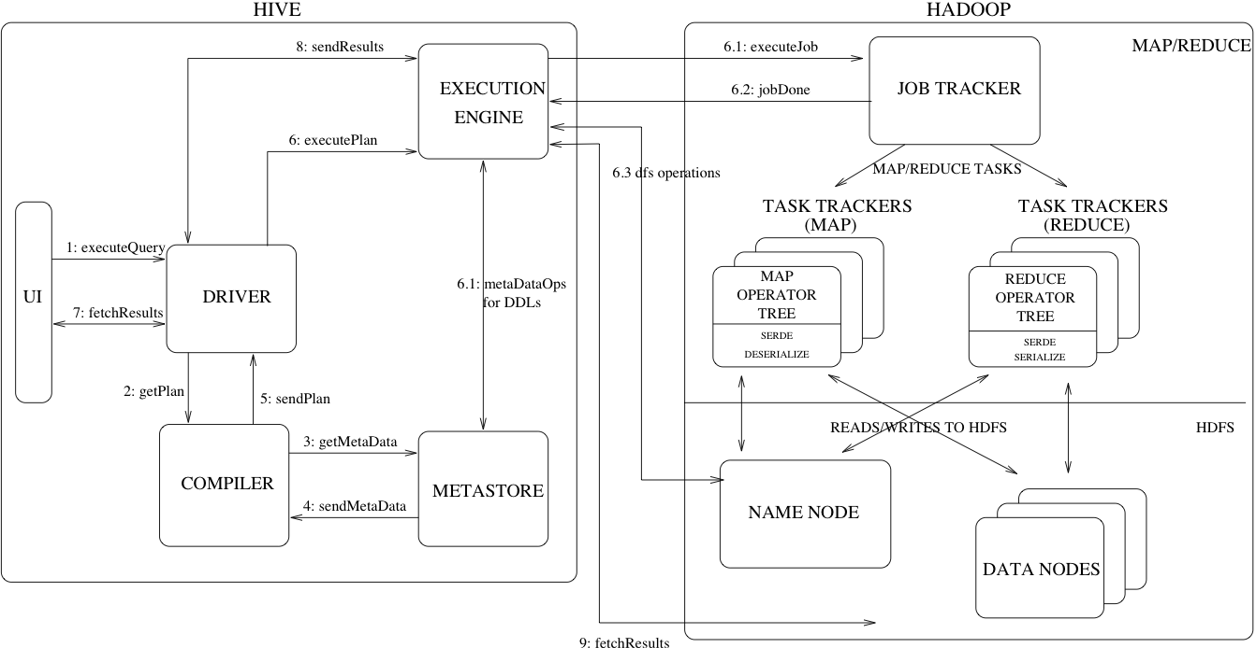
HIVE – under the hood
source: https://cwiki.apache.org/confluence/display/Hive/Design
Notes:
Hive is provides an SQL-like interface. It is actually an MapReduce engine with and HDFS storage backend.
It consists of several components:
A metastore, which contains information about the tables, their schemas, where they are located etc. If you specified location ‘/homes/yourname/hive’ when you created a database this is the directory where the metastore is located on hdfs.
- A Driver, this is the components that receives the SQL queries and is responsible of the orchestration between the other components to execute the query and return the results, in the order specified in the graph above.
A compiler, this component transforms the SQL queries into an optimized DAG of stages, using information it gets from the metastore. A stage is either a map reduce job, a Hive metadata operation, or an HDFS operation.
An execution engine, is the component responsible for executing the map reduce jobs created by the compiler. Most recents version of Hive uses Tez, which dynamically reconfigure the plan at run time to optimize the uses of available resource.
The backend is a Hadoop mapreduce engine. The important point is that data (tables content) is stored in HDFS and SQL queries on the data are transformed into map reduce jobs. It allows you to take any existing CSV, JSON, parquet (or other format), decorate this file with one or more schema meta data with the hive “create external table” (i.e. apply a database schema on it, the info is stored in the metastore), and execute SQL queries which are translated into map reduce jobs on the CSV, JSON, parquet data. In this case dropping an “external” Hive table will remove the metastore data but not the original data itself.
Students are encouraged to read https://cwiki.apache.org/confluence/display/Hive/Design for more info.

Slide 11
HIVE – under the hood
HBASE
source: https://cwiki.apache.org/confluence/display/Hive/Design
Notes:
Hive is provides an SQL-like interface. It is actually an MapReduce engine with and HDFS storage backend.
It consists of several components:
A metastore, which contains information about the tables, their schemas, where they are located etc. If you specified location ‘/homes/yourname/hive’ when you created a database this is the directory where the metastore is located on hdfs.
- A Driver, this is the components that receives the SQL queries and is responsible of the orchestration between the other components to execute the query and return the results, in the order specified in the graph above.
A compiler, this component transforms the SQL queries into an optimized DAG of stages, using information it gets from the metastore. A stage is either a map reduce job, a Hive metadata operation, or an HDFS operation.
An execution engine, is the component responsible for executing the map reduce jobs created by the compiler. Most recents version of Hive uses Tez, which dynamically reconfigure the plan at run time to optimize the uses of available resource.
The backend is a Hadoop mapreduce engine. The important point is that data (tables content) is stored in HDFS and SQL queries on the data are transformed into map reduce jobs. It allows you to take any existing CSV, JSON, parquet (or other format), decorate this file with one or more schema meta data with the hive “create external table” (i.e. apply a database schema on it, the info is stored in the metastore), and execute SQL queries which are translated into map reduce jobs on the CSV, JSON, parquet data. In this case dropping an “external” Hive table will remove the metastore data but not the original data itself.
Students are encouraged to read https://cwiki.apache.org/confluence/display/Hive/Design for more info.

Slide 12
HIVE - Hbase (or nosql) integration
Slow queries OLAP, BA
Hive (MapReduce)
Fast queries
HDFS
HBase
Streaming data (E.g Kafka, from sensor networks, IoT)

Slide 13
Homework 1 &
Tutorial Week 4
Spring 2020 - week #3

Slide 14
Start your engines
Find and fork the homework project under your group name https://renku.iccluster.epfl.ch/projects/dslab2020/dslab-homework-1/
Graded Homework DSLab_homework_1.ipynb
Push your changes to Renku before 24.03.2020 23:59:59
The tutorials of week 4 (not graded) contains many useful hints https://renku.iccluster.epfl.ch/projects/dslab2020/dslab-exercises-week-4/
Solutions of exercises week 3 are available at
https://renku.iccluster.epfl.ch/projects/dslab2020/dslab-solutions-week-3/
Notes:
python --version
conda search jupyter
conda install jupyter
conda list
conda search scikit-learn
# conda install scikit-learn=0.20.2=py37hebd9d1a_0
# conda list
conda deactivate
conda env remove -n DSLab2019

Slide 15
Thank you!

